Slide 1
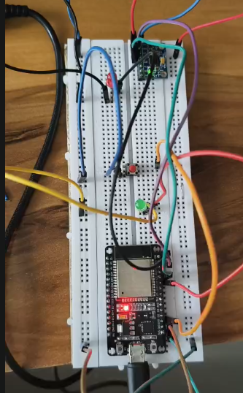
COMPUTATIONAL DATA SCIENCE • PROJECT PRESENTATION
From Sensor Readings
to Gait Insights
Exploratory Computational Analysis of Wearable Inertial Sensor Data
Grishma Makwana • 23BIT108
Prerita Shukla • 23BIT119

Slide 2
The complete project pipeline
ROADMAP
01 Hardware
02 Acquire
03 Organize
04 Validate
ESP32 + IMU sensor
Walking trials
Timestamped CSV files
Quality and timing checks
05 Explore
06 Transform
07 Compare
08 Investigate
Visualize six channels
Windows and features
Paired statistics
PCA, clustering, ML
OUTPUT: quality reports • feature tables • participant-level comparisons • exploratory visualizations
The goal is a transparent workflow from physical measurement to interpretable evidence—not a clinical diagnosis.
WEARABLE IMU • EXPLORATORY COMPUTATIONAL ANALYSIS
02

Slide 3
Motivation and potential applications
CONTEXT
Movement monitoring
Why study wearable gait signals?
Explore changes in movement signals over time.
• Raw accelerometer and gyroscope readings are difficult to interpret directly.
• Computational methods can summarize movement patterns as numerical features.
• Within-person left–right comparisons require careful analysis and uncertainty reporting.
Rehabilitation research
Potential support for studying movement consistency—not a validated clinical tool.
Wearable analytics
A foundation for future sensor-based analysis systems.
Scope boundary: this project explores a computational workflow; it does not diagnose gait disorders.
WEARABLE IMU • EXPLORATORY COMPUTATIONAL ANALYSIS
03

Slide 4
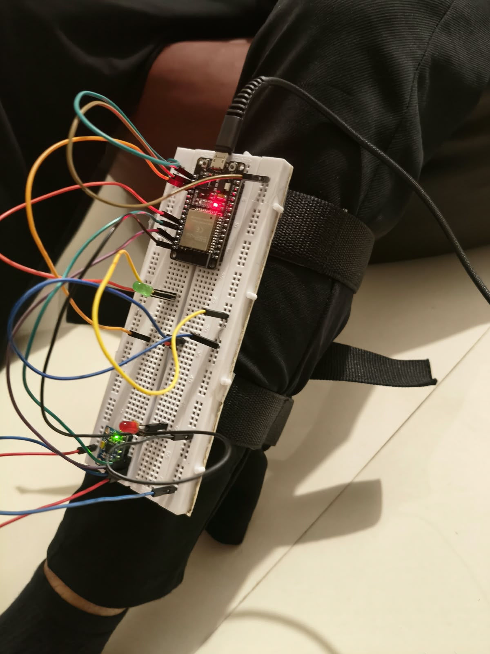
Hardware design and sensor selection
ACQUISITION
Controller
Motion sensor
ESP32 microcontroller
GY-521 module with MPU6050 IMU
Communication
Configured ranges
I²C
SDA GPIO 21
SCL GPIO 22
Accelerometer ±2 g and Gyroscope ±250°/s
The IMU measures acceleration and angular velocity on three axes each, producing six motion-related channels.
WEARABLE IMU • EXPLORATORY COMPUTATIONAL ANALYSIS
04

Slide 5
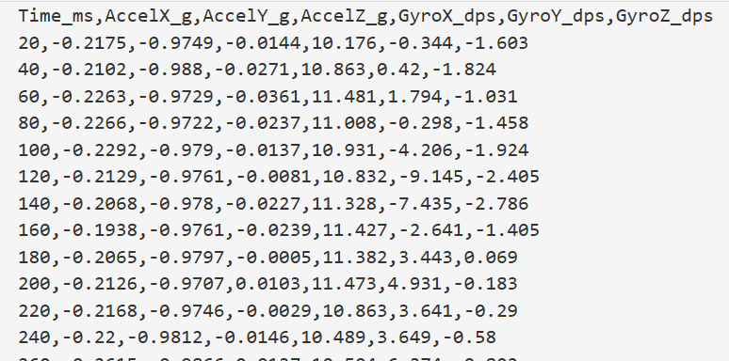
Data collection: from walking to raw readings
ACQUISITION
1. Mount
2. Record
3. Capture
Shin below knee; inverted orientation, top facing ground.
Barefoot walking on a flat surface; approximately 10 seconds per leg.
Serial Monitor output copied and saved as CSV using Python.
Sampling interval
Sampling frequency
Readings per trial
20 ms nominal
50 Hz nominal
~500 samples
WEARABLE IMU • EXPLORATORY COMPUTATIONAL ANALYSIS
05

Slide 6
Dataset overview and data quality
DATA
24
12
~500
50 Hz
CSV files
participants
samples / recording
nominal rate
Timestamp
Accelerometer
Gyroscope
Time_ms — used to inspect timing and intervals.
AccelX/Y/Z_g — acceleration in g.
GyroX/Y/Z_dps — angular velocity in degrees/second.
Quality checks to report
• 498–500 rows per recording, 9.96–9.98 s, 50.0 Hz estimated from Time_ms
• No missing, duplicate or constant values; 5 recordings with dropped samples or a late start
• About 12% of samples sit at the ±2 g / ±250 °/s limits (probable range limit, not confirmed saturation)
• Missing / infinite values
• Duplicate timestamps and irregular intervals
• Constant channels, abrupt cutoffs and extreme values
WEARABLE IMU • EXPLORATORY COMPUTATIONAL ANALYSIS
06

Slide 7
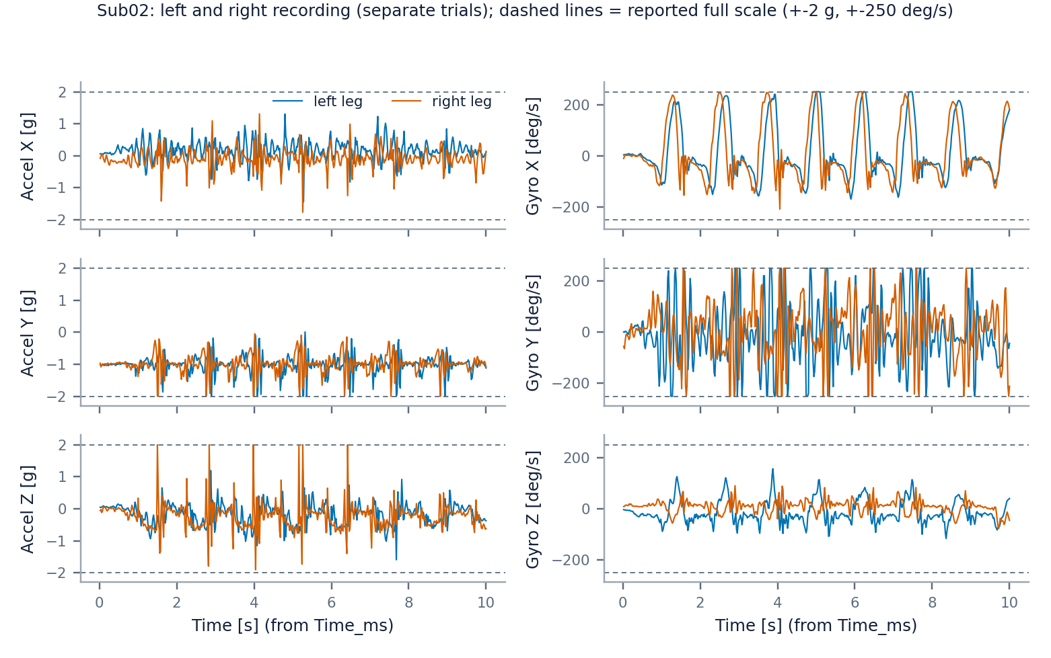
Computational workflow and signal exploration
EDA
Inspect patterns
Variation, spikes, plateaus and changes over time.
Check orientation
Gravity direction and sensor mounting affect channel values.
Flag uncertainty
An extreme value may reflect movement or measurement artefact.
WEARABLE IMU • EXPLORATORY COMPUTATIONAL ANALYSIS
07

Slide 8
Signal processing and feature extraction
REPRESENTATION
Raw signals
→
Windowing
→
Feature table
Six channels + timestamps
Fixed-length segments
Numerical descriptors
Time-domain features
Magnitude features
Mean • variance • min/max • peak-to-peak • RMS • energy
Acceleration and gyroscope vector norms; magnitude variability
Frequency-domain features
Cross-channel features
Dominant frequency • spectral energy
Axis correlations and selected channel relationships
Verified settings: 2.0 s windows (100 samples) • 50% overlap • 215 windows from 24 recordings • 184 features per row (183 testable)
WEARABLE IMU • EXPLORATORY COMPUTATIONAL ANALYSIS
08

Slide 9
Statistical analysis: comparing left and right
INFERENCE
Participant 1
Left
Right
→
Within-person difference
Paired inference
Feature
Feature
Compare legs within each participant.
Participant 2
Left
Right
→
Within-person difference
Feature
Feature
Uncertainty
Participant 3
Left
Right
→
Within-person difference
Effect sizes and confidence intervals.
Feature
Feature
Participant 4
Left
Right
→
Within-person difference
Multiplicity
Feature
Feature
Correct for testing many features.
Why participant-level pairing?
N = 12 participant pairs (24 recordings)
183 features tested; 0 significant after BH / Holm correction
Windows and samples from one person are not independent participants.
WEARABLE IMU • EXPLORATORY COMPUTATIONAL ANALYSIS
09

Slide 10
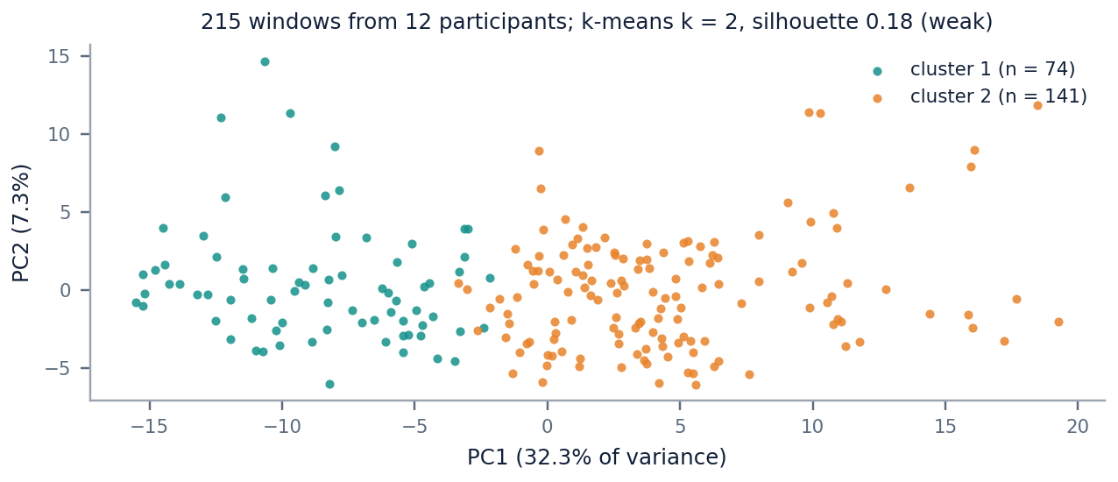
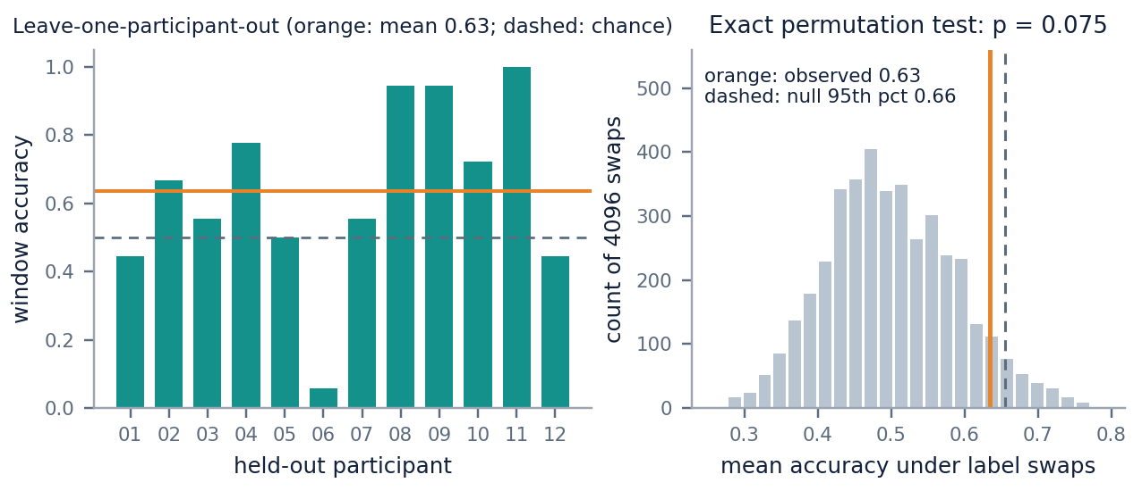
Exploratory machine learning
UNSUPERVISED / MODELS
PCA
Clustering
Anomaly detection
Classification
Summarize variation in feature space.
Explore whether feature vectors group together.
Flag windows unusual under a chosen model.
Test left/right predictability cautiously.
Interpretation: exploratory structure or unusual windows do not by themselves establish biological categories or abnormal gait.
WEARABLE IMU • EXPLORATORY COMPUTATIONAL ANALYSIS
10

Slide 11
Key findings, limitations and future work
TAKEAWAYS
What the data supports
Current limitations
Future Scope
• Signals show clear periodic gait-like structure, but about 12% of samples sit at the ±2 g / ±250 °/s limits.
• Paired analysis (12 participants, 183 features): no left/right difference established; none survive correction.
• Exploratory ML is inconclusive: classifier 0.63 (exact p = 0.075); outliers and clusters track participant and movement intensity.
• Small participant cohort and short trials
• Axis mapping / orientation uncertainty
• Possible saturation or firmware clamping
• No validated clinical ground truth
Longer, repeated trials
Standardized mounting and better wearable apparatus.
Expand participant cohort
Need Variety of people (with minor or major injuries in legs) for better model training.
WEARABLE IMU • EXPLORATORY COMPUTATIONAL ANALYSIS
11

Slide 12
CONCLUSION
From physical measurement to computational insight
A documented pipeline transforms wearable IMU recordings into quality checks, interpretable features, participant-level comparisons and exploratory machine-learning outputs.
Main contribution
Scientific boundary
A transparent and reproducible analysis workflow.
Current results are exploratory, not clinically validated.
Thank you

